Slide 1


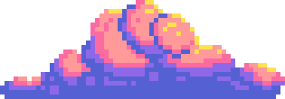




MENTAL HEALTH AND WELBEING
AI INNOVATORS

Slide 2
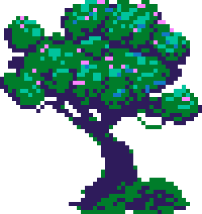


GAMIFICATION OF MENTAL HEALTH
Imagine if taking care of your mental health felt as engaging as playing a game. By using gamification, we can make self-care interactive, rewarding, and even fun—helping people stay motivated while breaking the stigma around mental well-being

Slide 3
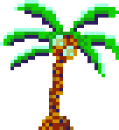

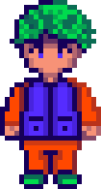

THE PROBLEM
Mental health solutions often feel like a chore, leading to low engagement
01
04
People struggle with consistency in self-care routines
How can we make mental health support more interactive and rewarding?
07

Slide 4
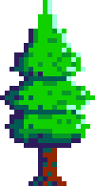
OUR SOLUTION
Gamification enhances motivation by incorporating rewards, streaks, and progression, making self-care feel more engaging. Studies show that gamification improves habit formation and mental well-being, increasing user retention and consistency. By transforming mental health routines into an interactive experience, we create a sustainable, long-term engagement model that encourages users to prioritize their well-being.

Slide 5


OUR UPROACH
01
Unlike passive mental health apps, our solution integrates AI-driven gamification to create a dynamic, engaging user experience.
Using interactive journaling, guided breathing, and rewards. We engage the user to be more attentive.
02
Utalising neural network and user data storage using json to create and mimic game asthetics and feel.
03

Slide 6
VISION
01
Future plans include AI-driven mood tracking and expansion into schools and workplaces.
Potential partnerships with mental health organizations for wider impact.
02
Scalable, adaptable, and built for long-term sustainability.
03

Slide 7
CONCLUSION
We make self-care engaging and sustainable through gamified mental health. Our AI-powered platform keeps users consistent and mindful. With support, we can expand, improve AI, and make mental health more accessible and effective.

Slide 8

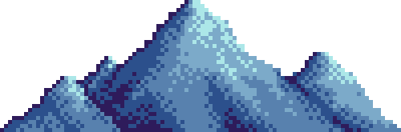
DEMO

Slide 9
THANK YOU

